Slide 1
INTRO TO JAVASCRIPT

Slide 2
Datatypes In Javascript
Two types – Primitive types, Non-primitive
Primitive Datatypes – data that is not an object and has no methods or properties eg, Number, Strings, Boolean, Null, Undefined,
No-primitive – Objects, Arrays

Slide 3
Variables In Javascript
Four main ways of Declaring Variables in Javascript
Using let keyword
Using var keyword
Using const keyword
Using nothing

Slide 4
CONDITIONALS IN JAVASCRIPT

Slide 5
Introduction to conditionals
Conditional statements are used to perform different actions based on different conditions.
In JavaScript we have the following conditional statements
if - to specify a block of code to be executed, if a specified condition is true
else - to specify a block of code to be executed if the same condition is false
else if - to specify a new condition to test if the first condition is false

Slide 6
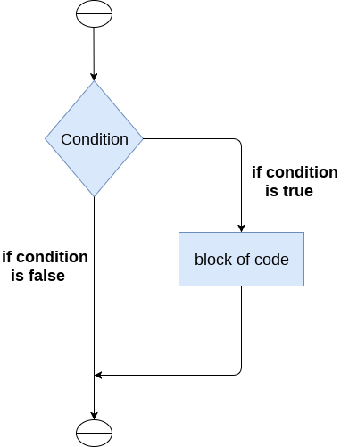
The if statement
Use the if statement to specify a block of JavaScript code to be executed if a condition is true.

Slide 7
If statement syntax
if (condition) {
// block of code to be executed if the condition is true
}
example
var age = 16
if(age<18) {
console.log("Not allowed to vote")
}
The result will be: "not allowed to vote" since the age is below 18 years.

Slide 8
The if-else statement
The if-else statement provides an else block combined with the if statement which is executed in the false case of the condition.
If the condition is true, then the if block is executed. Otherwise, the else block is executed.

Slide 9
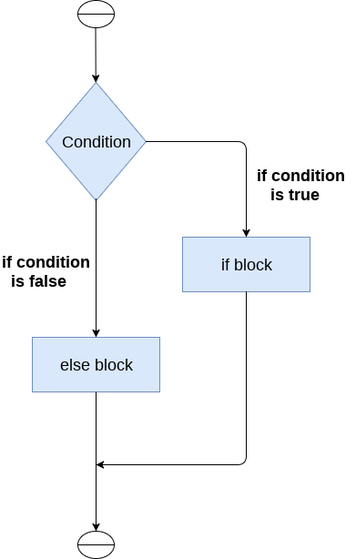

Slide 10
Syntax
if (condition) {
// block of code to be executed if the condition is true
} else {
// block of code to be executed if the condition is false
}
Example
var age= 16
if (age < 18) {
console.log("Not allowed to vote")
} else {
console.log("You can vote your favorite candidate")
}
output: “Not allowed to vote” this is because the age is less than 18 years otherwise if the age was above 18 years the output would be “You can vote your favorite candidate”

Slide 11
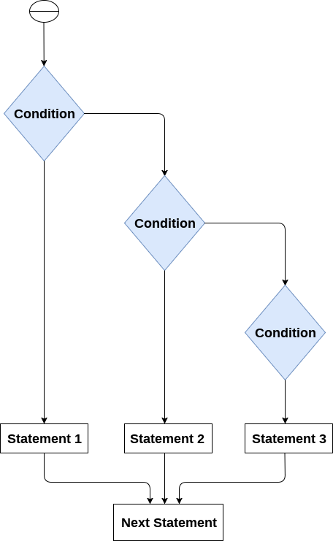
The else-if statement
We use the else if statement to specify a new condition if the first condition is false.

Slide 12
Syntax
if (condition1) {
// block of code to be executed if condition1 is true
} else if (condition2) {
// block of code to be executed if the condition1 is false and condition2 is true
} else {
// block of code to be executed if the condition1 is false and condition2 is false
}
Example
var people= 16;
if (people < 20) {
console.log("Less than 20 people turned out")
} else if (people > 30) {
console.log("Turn out was too high")
} else {
console.log("People turn out in a good number")
}
output: Less than 20 people turned out this is because the number that was declared was less than 20

Slide 13
Nested if statement
Nesting means writing a statement inside another statement
Example
var i=10;
if (i == 10) {
if (i < 15) {
console.log("i is less than 15");
// Nested - if statement
// Will only be executed if statement above it is true
if (i < 12) {
console.log("i is less than 12 too");
} else {
console.log("i is greater than 15");
}
}
}

Slide 14
Loops In Javascript
Looping in programming languages is a feature that facilitates the execution of a set of instructions/functions repeatedly while some condition evaluates to true.
There are mainly two types of loops:
Entry Controlled loops: In this type of loop, the test condition is tested before entering the loop body. For Loop and While Loop is entry-controlled loops.
Exit Controlled Loops: In this type of loop the test condition is tested or evaluated at the end of the loop body. Therefore, the loop body will execute at least once, irrespective of whether the test condition is true or false. The do-while loop is exit controlled loop.

Slide 15
Loops In Javascript
JavaScript supports different kinds of loops:
for - loops through a block of code a number of times.
for/in - loops through the properties of an object.
for/of - loops through the values of an itterable object.
while - loops through a block of code while a specified condition is true
do/while - also loops through a block of code while a specified condition is true

Slide 16
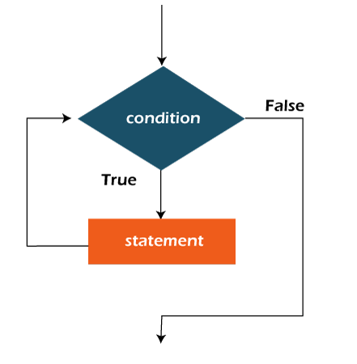
while loop
A while loop is a control flow statement that allows code to be executed repeatedly based on a given Boolean condition. The while loop can be thought of as a repeating if statement.

Slide 17
Syntax
while (boolean condition){
//loop statements...
}
Example
var x = 1;
// Exit when x becomes greater than 4
while(x <= 4){
console.log("Value of x:"+ x + "<br/>");
// increment the value of x for
// next iteration
x++;
}
Output:
Value of x:1, Value of x:2, Value of x:3, Value of x:4

Slide 18
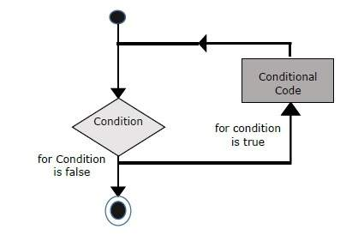
for loop
for loop provides a concise way of writing the loop structure. Unlike a while loop, a for statement consumes the initialization, condition, and increment/decrement in one line thereby providing a shorter, easy-to-debug structure of looping.

Slide 19
Syntax
for (init condition; testing condition; increment/decrement){
statement(s)
}
Example
var x;
// for loop begins when x=2
// and runs till x <=4
for(x = 2; x <= 4; x++) {
console.log("Value of x:"+ x + "<br />");
}
Output:
Value of x:2
Value of x:3
Value of x:4

Slide 20
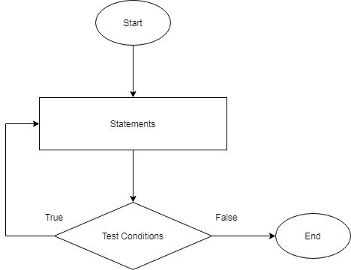
do-while
The do-while loop is similar to a while loop the only difference is that it checks for conditions after executing the statements, and therefore is an example of an Exit Control Loop

Slide 21
do-while
do{
statements..
}
while (condition);
Example
var x = 21;
do {
// The line while be printer even
// if the condition is false
console.log("Value of x:"+ x + "<br/>");
x++;
} while(x < 20);
Output:
Value of x: 21

Slide 22
FUNCTIONS IN JAVASCRIPT

Slide 23
Functions in JavaScript
Like other programming languages, JavaScript also supports the use of functions.
JavaScript function is a set of statements or instructions combined together to perform a particular task.
We can create functions in JavaScript using the keyword function. The basic syntax to create a function in JavaScript is shown below

Slide 24
Syntax:
function functionName(Parameter1, Parameter2, ..){
// Function body
}
Below are the rules for creating a function in JavaScript:
Every function should begin with the keyword function followed by,
A user-defined function name that should be unique,
A list of parameters is enclosed within parentheses and separated by commas,
A list of statements composing the body of the function enclosed within curly braces {}.

Slide 25
Calling a function.
A function cannot be executed before it is called. A function call is simply telling the function to execute the block of codes inside its curly braces {}
Example
function functionName(Parameter1, Parameter2, ..){
// Function body
}
functionName() // calling the function

Slide 26
function displaySum(){
let a = 20
let b = 22
let sum = a + b
console.log(sum)
}
displaySum()
function welcome(name) {
console.log("Hey "+""+name+" "+"welcome to PLP");
}
welcome(“Evans");
function add(a, b){
return a+b ;
// The return statement stops the execution of a function and returns a value
}
console.log(add(5, 4))

